Slide 1
Group #2 Milestone #3

Slide 2
Scope
Milestone #1 | Importance of Big Data Security Big Data Security Technologies
Milestone #2 | Big Data Security Risk
Milestone #3 | Big Data Security Use Cases
Milestone #4 | Big Data Security Issues Regulations and Policies
Milestone #5 | Implementation Part 1
Milestone #6 | Implementation Part 2
Milestone #7 | Implementation Part 3

Slide 3
Agenda
Discuss the Third Milestone
Big Data Security Use Cases
Conclusion

Slide 4

Big Data Security Use Cases
1) Cloud Security Monitoring
Threat intelligence analysis
Preventing Sharing Personal Data on the Cloud
Detecting and Intercepting Untrusted Software
Prevention of Unauthorized Collection of Data
https://www.cloud4y.com/blog/private-cloud-solution/
Notes:
Notes:
Threat Intelligence data provides perspective on attacker source, indicators of potential breach and behavioral trends interconnected to a variety of cloud environments and its services. For instance, threat intelligence feeds can be combined and analyzed by machine learning on the cloud. Feeds could also be used in some use cases of predictability models.
Many corporate cloud software scan any document before uploading to the cloud. In case of detection of personal information, the upload would be aborted. Software would implement autonomous remediation which notifies the user regarding the event and make him or her delete specified data.
Suppose an employee installed add-on application, when the untrusted application would try to steal the data from the cloud, security monitoring will detect and stop the attempt.
Unauthorized collection of data is a substantial issue. Cloud security monitoring will block any attempt of downloading previously allocated data to personal device. Other instance, it would prevent upload of specified files from company’s desktop.
References:
Shackleford, D. (2020, May 27). Top 6 cloud security analytics use cases. Searchcloudsecurity. https://searchcloudsecurity.techtarget.com/tip/Top-6-cloud-security-analytics-use-cases

Slide 5
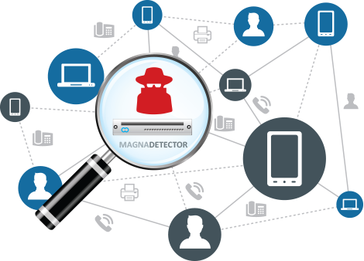
Big Data Security Use Cases
2) Network Traffic Analysis
Collect real-time and historical records of network activity.
Detecting the use of vulnerable protocols.
Troubleshooting slow networks.
Detecting any malware activity on the network in real-time.
https://www.seekpng.com/ima/u2w7y3o0r5i1r5o0/
Notes:
Notes:
The key goal of Network traffic analysis is to establish a mindset is not “if”, but “when” an attack happens.
Collecting and using network data events is crucial tool for monitoring real-time traffic on the network. To make this method more efficient, IT professional should be instructed what types of data is more valuable for the business and identify the budget of a project. Big Data can be implemented for real-time traffic analysis on the network. It can detect security vulnerabilities in the protocols, automatically troubleshoot slow network connections, detect malware activity, and alert users if it detects any serious anomaly which threatens the server.
References :
Rapid7. (n.d.). What is Network Traffic Analysis (NTA) and Monitoring? Retrieved June 18, 2021, from https://www.rapid7.com/fundamentals/network-traffic-analysis/

Slide 6
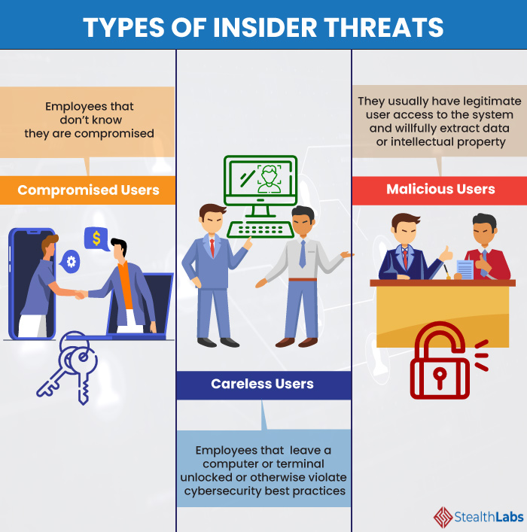
Big Data Security Use Cases
3) Insider Threat Detection
Abnormal Login Times
Badging into Work at Unusual Times
Logging in from Unexpected Location
Copying Large Amounts of Information
https://www.stealthlabs.com/blog/what-measures-should-you-adopt-for-managing-insider-threats/
Notes:
Notes:
We discussed that Insider Threat is one of the biggest security risk faced by Big Data Companies and it is very challenging to fight it effectively. As you can see on the picture there are 3 types of insider threats. Compromised user whose credentials were stolen and there are unaware of that. Careless user is person who leaves his or her device unattended. In government and particularly military, it is a chargeable offence to leave your workstation without logging off. Malicious User is a legitimate employee who steals and sells the company’s secrets for revenge or financial gains. However, Big Data can aid us in this case as well. Big Data can be used to analyze employee work patterns to detect suspicious activities such as abnormal login time, login from unexpected locations, copying large amounts of data, trying to access confidential information, etc.
References:
Matthews, T. (2021, February 1). What Is an Insider Threat? Understand the Problem and Discover 4 Defensive Strategies. Exabeam. https://www.exabeam.com/ueba/insider-threats/

Slide 7

Big Data Security Use Cases
4) Threat Hunting
Event-Based Hunting: based on observation and deep understanding on log source
IOC-Based Hunting: forensic data found in system logs
Entity-Based Hunting: focuses on high risk users and high value assets
Tactics, Techniques, and Procedures: usage of technology such as ML (Machine Learning)
https://www.forescout.com/company/blog/successful-threat-hunting-in-ics-networks/
Notes:
Notes:
It is always smart to be proactive when it comes to cyber-security. Threat hunting is the process of searching for undetected threats in vulnerabilities in the system and network. Big Data can be very helpful in this process and can be used in a variety of ways.
Even-based: Building a model that is based on hypotheses. History of event observation and understanding each log-source.
IOC-based Hunting: IOC stands for bit of forensic data which could be found in files, logs and malicious activities on the network. Knowing the footprints, we could easily identify similar events in the future.
Entity: Identifying the most valuable assets (HVA) and high-risk users (HRU). Expecting an attack to be target for the assets or source of the attack from HRU.
Tactics: Constant track of technologies and tools attackers use; and adopt the change if it is necessary.
References:
WissenX Akademie. (2020, October 11). Threat Hunting Tutorial for Beginners | Techniques | Security Operations | VAPT SOC SIEM [Video]. YouTube. https://www.youtube.com/watch?v=fUnxpB3GNHc
CrowdStrike. (2021, April 13). Proactive Threat Hunting Guide | What is Cyber Threat Hunting? Crowdstrike.Com. https://www.crowdstrike.com/cybersecurity-101/threat-hunting/

Slide 8
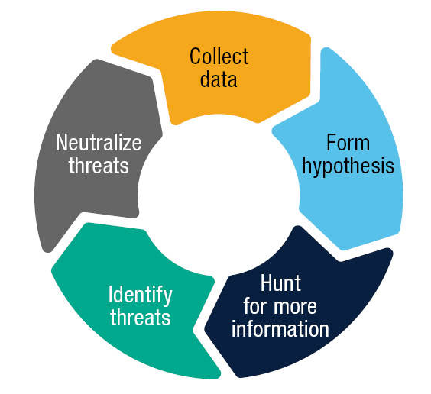
Big Data Security Use Cases
THREAT HUNTING LIFE CYCLE
Threat Hunting Life Cycle
Collect relevant data from the system
Form hypothesis about potential vulnerability in the system
Hunt for more information about the system and potential vulnerability
Identify the vulnerability in the system
Neutralize the vulnerability
https://www.crowe.com/cybersecurity-watch/hunting-the-hunters
Notes:
Notes:
No matter what approach we choose for threat hunting, the threat hunting life cycle is the same for every approach.
First, we collect relevant data from the system such as security configurations, protocols, and system information.
Then we analyze that information and form our hypothesis about potential risks about the system.
Then we collect more information to prove the existence of the vulnerability in the system.
After that we identify the threats and its root causes.
Then we neutralize the threat to secure the system.
References:
Cowie, C., & Salihoglu, M. (2020, August 11). Hunting the Hunters: Identifying Threats Early and Often. Crowe LLP. https://www.crowe.com/cybersecurity-watch/hunting-the-hunters
CrowdStrike. (2021, April 13). Proactive Threat Hunting Guide | What is Cyber Threat Hunting? Crowdstrike.Com. https://www.crowdstrike.com/cybersecurity-101/threat-hunting/

Slide 9
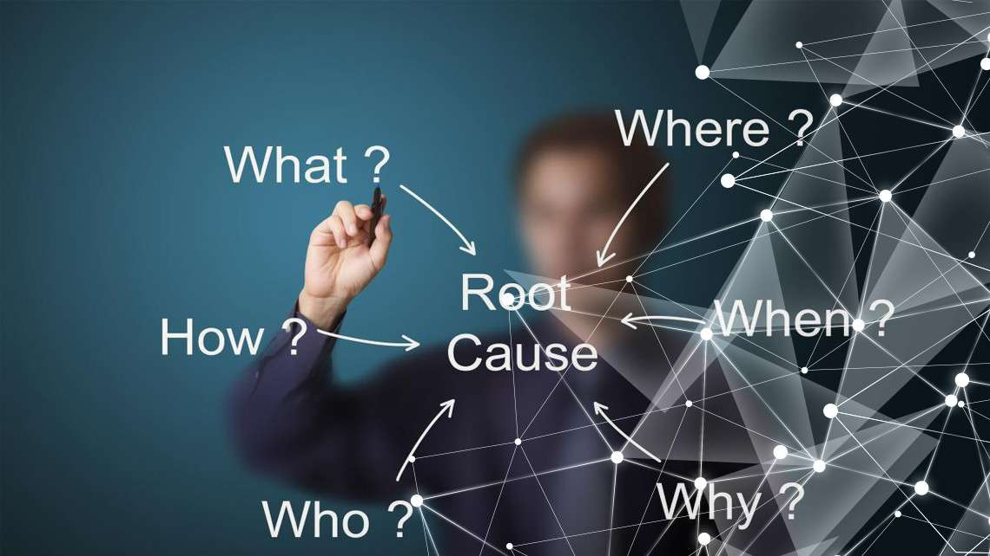
Big Data Security Use Cases
5) Incident Investigation
Assemble security investigation team.
Automate the incident investigation.
Analyze and use collected data to prevent future issues
https://www.makrosafe.co.za/blog/Accident-and-Incident-Investigation-and-Report-Writing?cat=Injuries%20on%20Duty%20(IODs)
Notes:
Notes:
The stricter the security implementation of the system, the incidents will be reported to the company. However, not all these incidents will be actual threats and can just be false positives. It can become tedious for the security investigation team to investigate each incident and separate out the real incidents from the sea of false positives. Big data analytics can help automate this process by analyzing the data from the incident and detect certain patterns to identify real threats from the false positives.
References:
Cichonski, P., Millar, T., Grance, T., & Scarfone, K. (2012). Computer Security Incident Handling Guide. NIST. https://nvlpubs.nist.gov/nistpubs/SpecialPublications/NIST.SP.800-61r2.pdfLessing, E. (2019, Jan 16). Injuries on Duty (IODs).
Lessing, E. (2019, January 16). Injuries on Duty (IODs). Makrosafe. https://www.makrosafe.co.za/blog/Accident-and-Incident-Investigation-and-Report-Writing?cat=Injuries%20on%20Duty%20(IODs)

Slide 10

Big Data Security Use Cases
6) User Behavior Analysis
Identify Malicious Insider
Detect Compromised Accounts
Detect Breach of Protected Data
Track of Account Privilege Changes
https://digitalguardian.com/blog/what-user-and-entity-behavior-analytics-definition-ueba-benefits-how-it-works-and-more
Notes:
Notes:
Large systems have thousands or even millions of employees working on the system at the same time. They constantly fight insider threats, compromised accounts, and data exfiltration. In order to detect these attacks, the company needs to constantly monitor the user behaviour and identify any harmful activity from the users. If the company fails to detect it on time, it might cause huge harm to the company. Big Data Analytics can help the company monitor the user behaviour in real-time and check for various threat patterns in real-time.
References:
Team, T. (2021, June 16). Big Data Security – Implementation, Use cases and Issues. TechVidvan. https://techvidvan.com/tutorials/big-data-security/

Slide 11
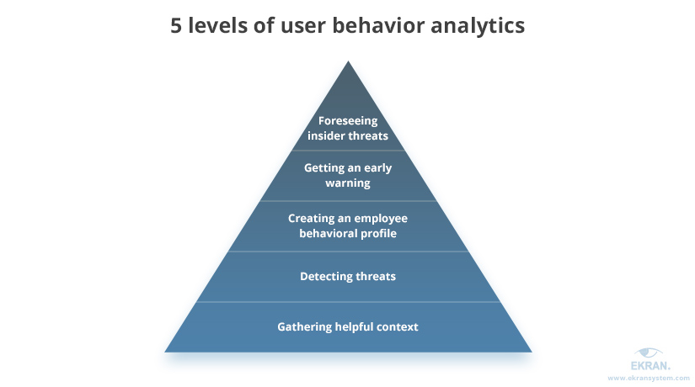
Big Data Security Use Cases
Five Levels of User Behavior Analytics
Level 1: Gathering information on system level such as events
Level 2: Detect suspicious activities based on system information
Level 3: Behavioral profile detects abnormal activities of a user
Level 4: Detect fraud, espionage and intellectual property theft
Level 5: Prevent and predicts insider threats by a complete behavioral profile
https://www.ekransystem.com/en/blog/5-levels-user-behavior-monitoring
Notes:
Notes:
User behaviour monitoring is highly effective to avert insider threats. In combination with more traditional cyber security tools discussed above, it would provide network analyst with a better idea of the network activities and users.
Levels 4 and 5 provide the most powerful types of user behavior analysis. 4: Based on collected data, we could prevent fraud, espionage, data exfiltration and etc.
References:
5 Levels of User Behavior Monitoring. (2019, August 14). Ekran. https://www.ekransystem.com/en/blog/5-levels-user-behavior-monitoring

Slide 12
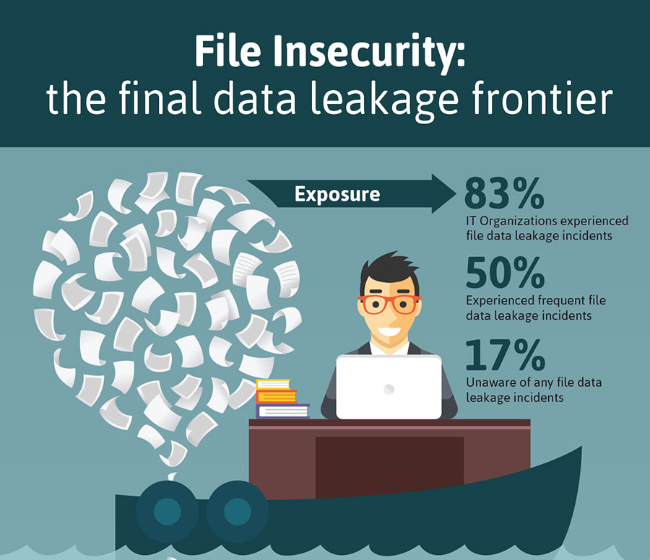
Big Data Security Use Cases
7) Data Exfiltration Detection
Unauthorized movement of data in and out of a network
SQL Injections can initiate data leakage
Phishing emails with malware
https://www.stoneforest.com.sg/docs/librariesprovider7/sfit_brochures/infographic/file-insecurity-1_final.jpg?sfvrsn=9d3ea535_4
Notes:
Notes:
Hackers can use different ways to try and exfiltrate data from our database. They can use SQL injection to access into user’s applications and database. An employee that lacks knowledge of basic security practices could become a victim of social engineering by clicking a malicious link to infect the device. Creating data base with domain misspelt and sent from a public email domain. Poorly written and automated attacks. Combine the finding to successfully prevent phishing email attacks. Big Data Analytics can be used to detect certain patterns in the network activity and stop these attempts before they can steal any data.
References:
Team, T. (2021, June 16). Big Data Security – Implementation, Use cases and Issues. TechVidvan. https://techvidvan.com/tutorials/big-data-security/
SQL injection. (n.d.). Portswigger. Retrieved June 17, 2021, from https://portswigger.net/web-security/sql-injection

Slide 13
Conclusion
As number of online interactions increase exponentially, the investment into safe keep of data surge as well. Any company that works with Big Data should consider every use case provided and implement the most suitable solution for its business. The importance of clients and employees trust as high as never before.

